Slide 1
SOA Exam FM
Module 3 – Section 6 (Part 3)
Bond Bought at Par Example

Slide 2
Example
You buy a 4-year 1000 face value bond, redeemable at 1200, with 3% annual coupons. Determine the price of the bond to yield 2.5% annual effective.

Slide 3
Example
You buy a 4-year 1000 face value bond, redeemable at 1200, with 3% annual coupons. Determine the price of the bond to yield 2.5% annual effective.
$$1200$$
$$30$$
$$30$$
$$30$$
$$30$$
$$1$$
$$2$$
$$3$$
$$4$$
$$P$$

Slide 4
Example
You buy a 4-year 1000 face value bond, redeemable at 1200, with 3% annual coupons. Determine the price of the bond to yield 2.5% annual effective.
$$1200$$
$$30$$
$$30$$
$$30$$
$$30$$
$$1$$
$$2$$
$$3$$
$$4$$
$$P$$
$$=30a_{\overline{4}|0.025}+1200v_{0.025}^{4}$$

Slide 5
Example
You buy a 4-year 1000 face value bond, redeemable at 1200, with 3% annual coupons. Determine the price of the bond to yield 2.5% annual effective.
$$1200$$
$$30$$
$$30$$
$$30$$
$$30$$
$$1$$
$$2$$
$$3$$
$$4$$
$$P$$
$$=30a_{\overline{4}|0.025}+1200v_{0.025}^{4}$$
$$=1200.00$$

Slide 6
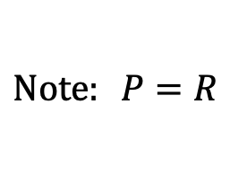
Example
You buy a 4-year 1000 face value bond, redeemable at 1200, with 3% annual coupons. Determine the price of the bond to yield 2.5% annual effective.
$$1200$$
$$30$$
$$30$$
$$30$$
$$30$$
$$1$$
$$2$$
$$3$$
$$4$$
$$P$$
$$=30a_{\overline{4}|0.025}+1200v_{0.025}^{4}$$
$$=1200.00$$
$$Note: P=R$$

Slide 7
Example
You buy a 4-year 1000 face value bond, redeemable at 1200, with 3% annual coupons. Determine the price of the bond to yield 2.5% annual effective.
$$1200$$
$$30$$
$$30$$
$$30$$
$$30$$
$$1$$
$$2$$
$$3$$
$$4$$
$$P$$
$$=30a_{\overline{4}|0.025}+1200v_{0.025}^{4}$$
$$=1200.00$$
$$Note: P=R$$
$$When P=R, the bond is said to be “bought at par”.$$

Slide 8
Example
You buy a 4-year 1000 face value bond, redeemable at 1200, with 3% annual coupons. Determine the price of the bond to yield 2.5% annual effective.
$$1200$$
$$30$$
$$30$$
$$30$$
$$30$$
$$1$$
$$2$$
$$3$$
$$4$$
$$P$$
$$=30a_{\overline{4}|0.025}+1200v_{0.025}^{4}$$
$$=1200.00$$
$$Note: P=R$$
$$When P=R, the bond is said to be “bought at par”.$$
$$BEWARE:Bought at Par means P=R.$$

Slide 9
Example
You buy a 4-year 1000 face value bond, redeemable at 1200, with 3% annual coupons. Determine the price of the bond to yield 2.5% annual effective.
$$1200$$
$$30$$
$$30$$
$$30$$
$$30$$
$$1$$
$$2$$
$$3$$
$$4$$
$$P$$
$$=30a_{\overline{4}|0.025}+1200v_{0.025}^{4}$$
$$=1200.00$$
$$Note: P=R$$
$$When P=R, the bond is said to be “bought at par”.$$
$$BEWARE:Bought at Par means P=R.$$
$$(Confusing:It does NOT mean P=F)$$

Slide 10
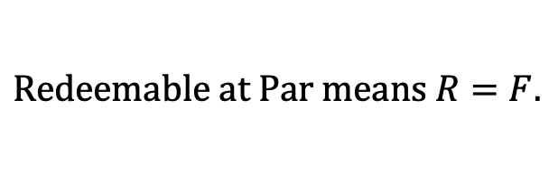
Example
You buy a 4-year 1000 face value bond, redeemable at 1200, with 3% annual coupons. Determine the price of the bond to yield 2.5% annual effective.
$$1200$$
$$30$$
$$30$$
$$30$$
$$30$$
$$1$$
$$2$$
$$3$$
$$4$$
$$P$$
$$=30a_{\overline{4}|0.025}+1200v_{0.025}^{4}$$
$$=1200.00$$
$$Note: P=R$$
$$When P=R, the bond is said to be “bought at par”.$$
$$BEWARE:Bought at Par means P=R.$$
$$(Confusing:It does NOT mean P=F)$$
$$Redeemable at Par means R=F.$$

Slide 11
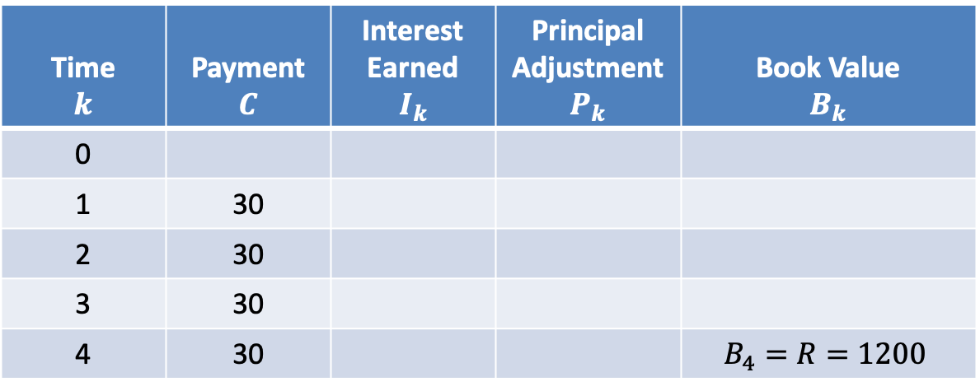
$$Amortization Table$$
$$i=0.025$$
Time $$k$$ | Payment $$C$$ | Interest Earned $$I_{k}$$ | Principal Adjustment $$P_{k}$$ | Book Value $$B_{k}$$
0
1 | 30
2 | 30
3 | 30
4 | 30 |  |  | $$B_{4}=R=1200$$

Slide 12
$$Amortization Table$$
$$i=0.025$$
Time $$k$$ | Payment $$C$$ | Interest Earned $$I_{k}$$ | Principal Adjustment $$P_{k}$$ | Book Value $$B_{k}$$
0
1 | 30
2 | 30
3 | 30
4 | 30 |  |  | $$B_{4}=R=1200$$
$$P$$
$$=30a_{\overline{4}|0.025}+1200v_{0.025}^{4}$$
$$=1200.00$$

Slide 13
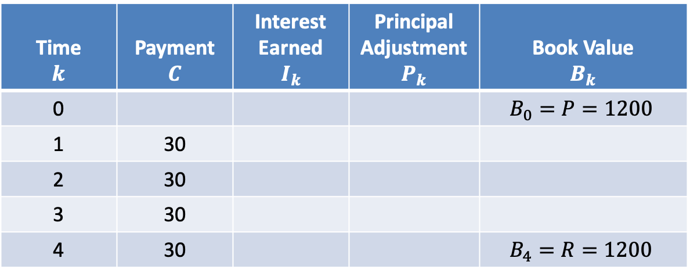
$$Amortization Table$$
$$i=0.025$$
Time $$k$$ | Payment $$C$$ | Interest Earned $$I_{k}$$ | Principal Adjustment $$P_{k}$$ | Book Value $$B_{k}$$
0 |  |  |  | $$B_{0}=P=1200$$
1 | 30
2 | 30
3 | 30
4 | 30 |  |  | $$B_{4}=R=1200$$

Slide 14
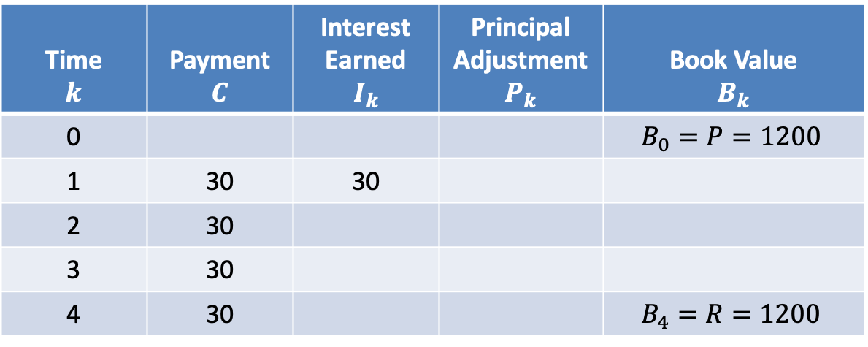
$$Amortization Table$$
$$i=0.025$$
Time $$k$$ | Payment $$C$$ | Interest Earned $$I_{k}$$ | Principal Adjustment $$P_{k}$$ | Book Value $$B_{k}$$
0 |  |  |  | $$B_{0}=P=1200$$
1 | 30 | 30
2 | 30
3 | 30
4 | 30 |  |  | $$B_{4}=R=1200$$
$$I_{1}=0.025∙1200=30$$

Slide 15
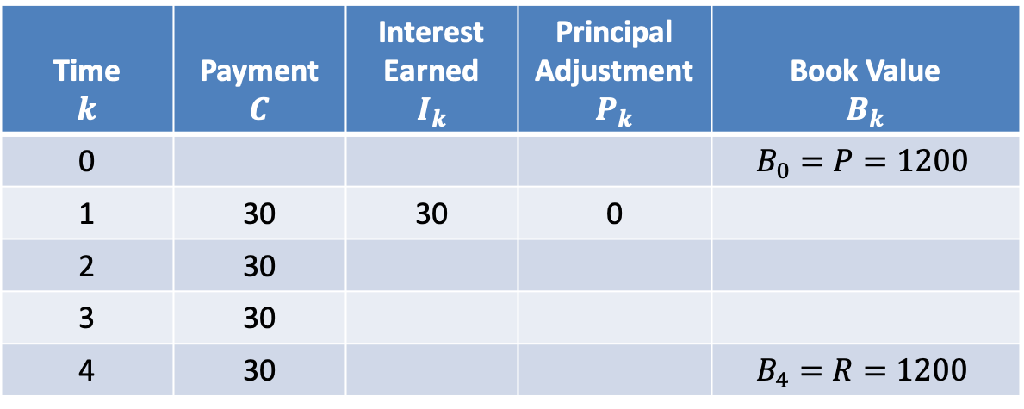
$$Amortization Table$$
$$i=0.025$$
Time $$k$$ | Payment $$C$$ | Interest Earned $$I_{k}$$ | Principal Adjustment $$P_{k}$$ | Book Value $$B_{k}$$
0 |  |  |  | $$B_{0}=P=1200$$
1 | 30 | 30 | 0
2 | 30
3 | 30
4 | 30 |  |  | $$B_{4}=R=1200$$
$$I_{1}=0.025∙1200=30$$
$$P_{1}=30−30=0$$

Slide 16
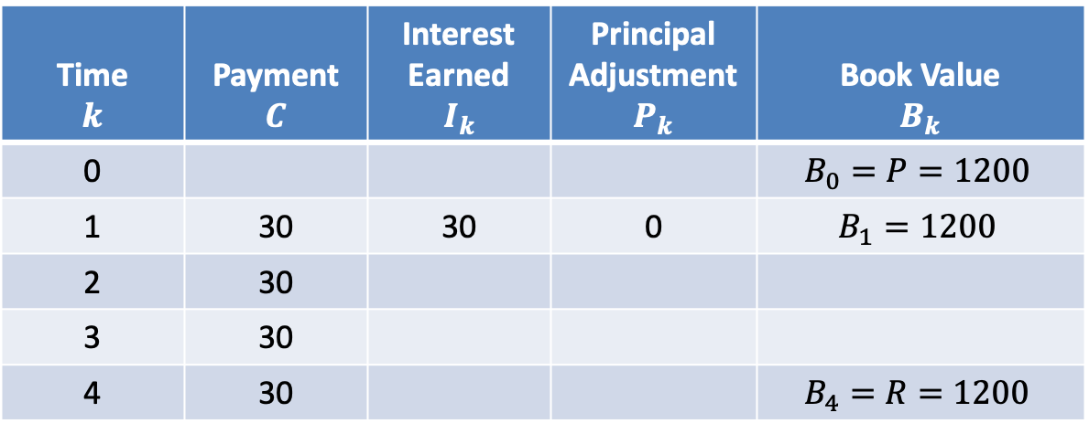
$$Amortization Table$$
$$i=0.025$$
Time $$k$$ | Payment $$C$$ | Interest Earned $$I_{k}$$ | Principal Adjustment $$P_{k}$$ | Book Value $$B_{k}$$
0 |  |  |  | $$B_{0}=P=1200$$
1 | 30 | 30 | 0 | $$B_{1}=1200$$
2 | 30
3 | 30
4 | 30 |  |  | $$B_{4}=R=1200$$
$$I_{1}=0.025∙1200=30$$
$$P_{1}=30−30=0$$
$$B_{1}=1200−0=1200$$

Slide 17
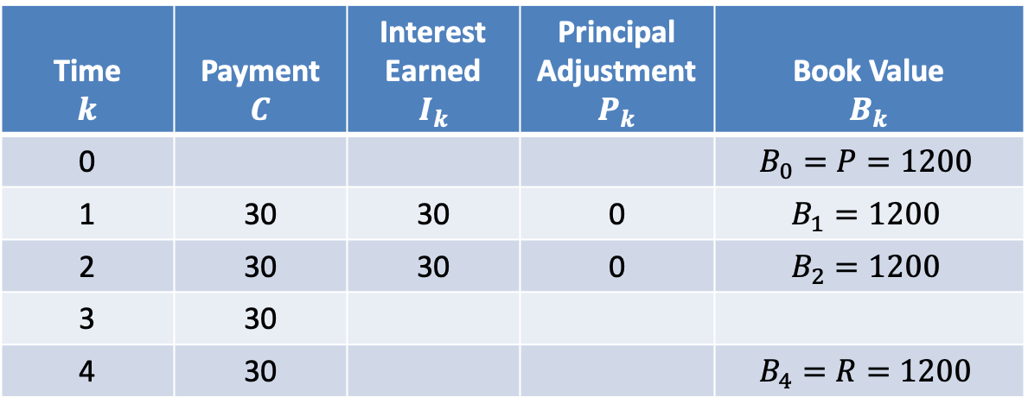
$$Amortization Table$$
$$i=0.025$$
Time $$k$$ | Payment $$C$$ | Interest Earned $$I_{k}$$ | Principal Adjustment $$P_{k}$$ | Book Value $$B_{k}$$
0 |  |  |  | $$B_{0}=P=1200$$
1 | 30 | 30 | 0 | $$B_{1}=1200$$
2 | 30 | 30 | 0 | $$B_{2}=1200$$
3 | 30
4 | 30 |  |  | $$B_{4}=R=1200$$

Slide 18
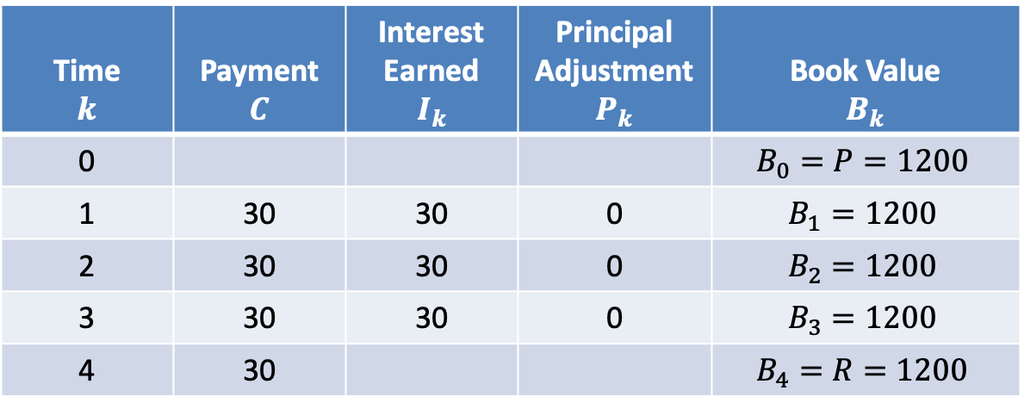
$$Amortization Table$$
$$i=0.025$$
Time $$k$$ | Payment $$C$$ | Interest Earned $$I_{k}$$ | Principal Adjustment $$P_{k}$$ | Book Value $$B_{k}$$
0 |  |  |  | $$B_{0}=P=1200$$
1 | 30 | 30 | 0 | $$B_{1}=1200$$
2 | 30 | 30 | 0 | $$B_{2}=1200$$
3 | 30 | 30 | 0 | $$B_{3}=1200$$
4 | 30 |  |  | $$B_{4}=R=1200$$

Slide 19
$$Amortization Table$$
$$i=0.025$$
Time $$k$$ | Payment $$C$$ | Interest Earned $$I_{k}$$ | Principal Adjustment $$P_{k}$$ | Book Value $$B_{k}$$
0 |  |  |  | $$B_{0}=P=1200$$
1 | 30 | 30 | 0 | $$B_{1}=1200$$
2 | 30 | 30 | 0 | $$B_{2}=1200$$
3 | 30 | 30 | 0 | $$B_{3}=1200$$
4 | 30 | 30 | 0 | $$B_{4}=R=1200$$

Slide 20
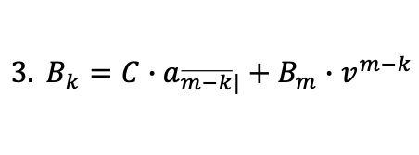
$$Amortization Table$$
$$i=0.025$$
Time $$k$$ | Payment $$C$$ | Interest Earned $$I_{k}$$ | Principal Adjustment $$P_{k}$$ | Book Value $$B_{k}$$
0 |  |  |  | $$B_{0}=P=1200$$
1 | 30 | 30 | 0 | $$B_{1}=1200$$
2 | 30 | 30 | 0 | $$B_{2}=1200$$
3 | 30 | 30 | 0 | $$B_{3}=1200$$
4 | 30 | 30 | 0 | $$B_{4}=R=1200$$
$$General Remarks:$$
$$1. \left\{P_{1},P_{2},…,P_{n}\right\} is a geometric sequence with common ratio r=1+i$$
$$2. \sum{P_{k}}=P_{1}+P_{2}+…+P_{n}$$
$$=P_{1}\left(1+ (1+i)+…+{(1+i)}^{n−1}\right)$$
$$=P_{1}∙s_{\overline{n}|}$$
$$=P−R$$
$$3. B_{k}=C∙a_{\overline{m−k}|}+B_{m}∙v^{m−k}$$
$$\left(k<m\right) one step TVM calculation$$

Slide 21
$$Amortization Table$$
$$i=0.025$$
Time $$k$$ | Payment $$C$$ | Interest Earned $$I_{k}$$ | Principal Adjustment $$P_{k}$$ | Book Value $$B_{k}$$
0 |  |  |  | $$B_{0}=P=1200$$
1 | 30 | 30 | 0 | $$B_{1}=1200$$
2 | 30 | 30 | 0 | $$B_{2}=1200$$
3 | 30 | 30 | 0 | $$B_{3}=1200$$
4 | 30 | 30 | 0 | $$B_{4}=R=1200$$
$$Question:Determine a condition required in order for a bond to be bought at par.$$

Slide 22
$$Amortization Table$$
$$i=0.025$$
Time $$k$$ | Payment $$C$$ | Interest Earned $$I_{k}$$ | Principal Adjustment $$P_{k}$$ | Book Value $$B_{k}$$
0 |  |  |  | $$B_{0}=P=1200$$
1 | 30 | 30 | 0 | $$B_{1}=1200$$
2 | 30 | 30 | 0 | $$B_{2}=1200$$
3 | 30 | 30 | 0 | $$B_{3}=1200$$
4 | 30 | 30 | 0 | $$B_{4}=R=1200$$
$$Question:Determine a condition required in order for a bond to be bought at par.$$
$$At purchase, we know the values of F, R, r, and i.$$

Slide 23
$$Amortization Table$$
$$i=0.025$$
Time $$k$$ | Payment $$C$$ | Interest Earned $$I_{k}$$ | Principal Adjustment $$P_{k}$$ | Book Value $$B_{k}$$
0 |  |  |  | $$B_{0}=P=1200$$
1 | 30 | 30 | 0 | $$B_{1}=1200$$
2 | 30 | 30 | 0 | $$B_{2}=1200$$
3 | 30 | 30 | 0 | $$B_{3}=1200$$
4 | 30 | 30 | 0 | $$B_{4}=R=1200$$
$$Question:Determine a condition required in order for a bond to be bought at par.$$
$$At purchase, we know the values of F, R, r, and i.$$
$$We need the payment coupon and the interest earned each installment to be equal.$$

Slide 24
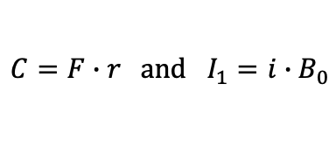
$$Amortization Table$$
$$i=0.025$$
Time $$k$$ | Payment $$C$$ | Interest Earned $$I_{k}$$ | Principal Adjustment $$P_{k}$$ | Book Value $$B_{k}$$
0 |  |  |  | $$B_{0}=P=1200$$
1 | 30 | 30 | 0 | $$B_{1}=1200$$
2 | 30 | 30 | 0 | $$B_{2}=1200$$
3 | 30 | 30 | 0 | $$B_{3}=1200$$
4 | 30 | 30 | 0 | $$B_{4}=R=1200$$
$$Question:Determine a condition required in order for a bond to be bought at par.$$
$$At purchase, we know the values of F, R, r, and i.$$
$$We need the payment coupon and the interest earned each installment to be equal.$$
$$C=F∙r and I_{1}=i∙B_{0}$$

Slide 25
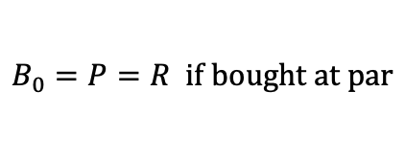
$$Amortization Table$$
$$i=0.025$$
Time $$k$$ | Payment $$C$$ | Interest Earned $$I_{k}$$ | Principal Adjustment $$P_{k}$$ | Book Value $$B_{k}$$
0 |  |  |  | $$B_{0}=P=1200$$
1 | 30 | 30 | 0 | $$B_{1}=1200$$
2 | 30 | 30 | 0 | $$B_{2}=1200$$
3 | 30 | 30 | 0 | $$B_{3}=1200$$
4 | 30 | 30 | 0 | $$B_{4}=R=1200$$
$$Question:Determine a condition required in order for a bond to be bought at par.$$
$$At purchase, we know the values of F, R, r, and i.$$
$$We need the payment coupon and the interest earned each installment to be equal.$$
$$C=F∙r and I_{1}=i∙B_{0}$$
$$B_{0}=P=R if bought at par$$

Slide 26
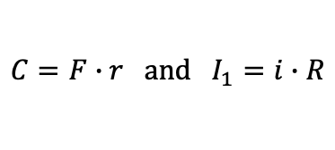
$$Amortization Table$$
$$i=0.025$$
Time $$k$$ | Payment $$C$$ | Interest Earned $$I_{k}$$ | Principal Adjustment $$P_{k}$$ | Book Value $$B_{k}$$
0 |  |  |  | $$B_{0}=P=1200$$
1 | 30 | 30 | 0 | $$B_{1}=1200$$
2 | 30 | 30 | 0 | $$B_{2}=1200$$
3 | 30 | 30 | 0 | $$B_{3}=1200$$
4 | 30 | 30 | 0 | $$B_{4}=R=1200$$
$$Question:Determine a condition required in order for a bond to be bought at par.$$
$$At purchase, we know the values of F, R, r, and i.$$
$$We need the payment coupon and the interest earned each installment to be equal.$$
$$C=F∙r and I_{1}=i∙R$$
$$B_{0}=P=R if bought at par$$

Slide 27
$$Amortization Table$$
$$i=0.025$$
Time $$k$$ | Payment $$C$$ | Interest Earned $$I_{k}$$ | Principal Adjustment $$P_{k}$$ | Book Value $$B_{k}$$
0 |  |  |  | $$B_{0}=P=1200$$
1 | 30 | 30 | 0 | $$B_{1}=1200$$
2 | 30 | 30 | 0 | $$B_{2}=1200$$
3 | 30 | 30 | 0 | $$B_{3}=1200$$
4 | 30 | 30 | 0 | $$B_{4}=R=1200$$
$$Question:Determine a condition required in order for a bond to be bought at par.$$
$$At purchase, we know the values of F, R, r, and i.$$
$$We need the payment coupon and the interest earned each installment to be equal.$$
$$C=F∙r and I_{1}=i∙R$$
$$B_{0}=P=R if bought at par$$
$$Answer: F∙r=R∙i in order for a bond to be bought at par.$$

Slide 28
Another Bond Pricing Formula
$$R$$
$$C$$
$$C$$
$$⋯$$
$$C$$
$$P$$
$$=Price$$

Slide 29
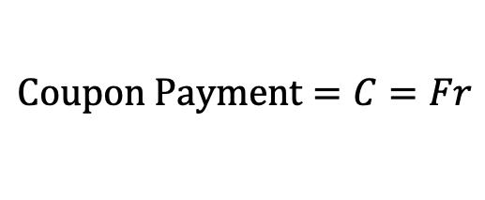
Another Bond Pricing Formula
$$R$$
$$C$$
$$C$$
$$⋯$$
$$C$$
$$P$$
$$=Price$$
$$Coupon Payment=C=Fr$$

Slide 30
Another Bond Pricing Formula
$$R$$
$$C$$
$$C$$
$$⋯$$
$$C$$
$$P$$
$$=Price$$
$$Coupon Payment=C=Fr$$
$$P=C∙a_{\overline{n}|}+R∙v^{n}$$

Slide 31
Another Bond Pricing Formula
$$R$$
$$C$$
$$C$$
$$⋯$$
$$C$$
$$P$$
$$=Price$$
$$Coupon Payment=C=Fr$$
$$P=Fr∙a_{\overline{n}|}+R∙v^{n}$$

Slide 32
Another Bond Pricing Formula
$$R$$
$$C$$
$$C$$
$$⋯$$
$$C$$
$$P$$
$$=Price$$
$$Coupon Payment=C=Fr$$
$$P=Fr∙a_{\overline{n}|}+R−R+R∙v^{n}$$

Slide 33
Another Bond Pricing Formula
$$R$$
$$C$$
$$C$$
$$⋯$$
$$C$$
$$P$$
$$=Price$$
$$Coupon Payment=C=Fr$$
$$P=Fr∙a_{\overline{n}|}+R−R(1−v^{n})$$

Slide 34
Another Bond Pricing Formula
$$R$$
$$C$$
$$C$$
$$⋯$$
$$C$$
$$P$$
$$=Price$$
$$Coupon Payment=C=Fr$$
$$P=Fr∙a_{\overline{n}|}+R−R(1−v^{n})$$
$$∙\frac{i}{i}$$

Slide 35
Another Bond Pricing Formula
$$R$$
$$C$$
$$C$$
$$⋯$$
$$C$$
$$P$$
$$=Price$$
$$Coupon Payment=C=Fr$$
$$P=Fr∙a_{\overline{n}|}+R−Ri∙a_{\overline{n}|}$$

Slide 36
Another Bond Pricing Formula
$$R$$
$$C$$
$$C$$
$$⋯$$
$$C$$
$$P$$
$$=Price$$
$$Coupon Payment=C=Fr$$
$$P=R+Fr∙a_{\overline{n}|}−Ri∙a_{\overline{n}|}$$

Slide 37
Another Bond Pricing Formula
$$R$$
$$C$$
$$C$$
$$⋯$$
$$C$$
$$P$$
$$=Price$$
$$Coupon Payment=C=Fr$$
$$P=R+(Fr−Ri)∙a_{\overline{n}|}$$

Slide 38
Another Bond Pricing Formula
$$R$$
$$C$$
$$C$$
$$⋯$$
$$C$$
$$P$$
$$=Price$$
$$Coupon Payment=C=Fr$$
$$P=R+(Fr−Ri)∙a_{\overline{n}|}$$
$$Sometimes referred to as the Premium/Discount Formula$$

Slide 39
Another Bond Pricing Formula
$$R$$
$$C$$
$$C$$
$$⋯$$
$$C$$
$$P$$
$$=Price$$
$$Coupon Payment=C=Fr$$
$$P=R+(Fr−Ri)∙a_{\overline{n}|}$$
$$Sometimes referred to as the Premium/Discount Formula$$
$$If Fr>Ri then the bond is bought at a premium of (Fr−Ri)∙a_{\overline{n}|}$$

Slide 40
Another Bond Pricing Formula
$$R$$
$$C$$
$$C$$
$$⋯$$
$$C$$
$$P$$
$$=Price$$
$$Coupon Payment=C=Fr$$
$$P=R+(Fr−Ri)∙a_{\overline{n}|}$$
$$Sometimes referred to as the Premium/Discount Formula$$
$$If Fr>Ri then the bond is bought at a premium of (Fr−Ri)∙a_{\overline{n}|}$$
$$If Fr<Ri then the bond is bought at a discount of |(Fr−Ri)|∙a_{\overline{n}|}$$

Slide 41
Another Bond Pricing Formula
$$R$$
$$C$$
$$C$$
$$⋯$$
$$C$$
$$P$$
$$=Price$$
$$Coupon Payment=C=Fr$$
$$P=R+(Fr−Ri)∙a_{\overline{n}|}$$
$$Sometimes referred to as the Premium/Discount Formula$$
$$If Fr>Ri then the bond is bought at a premium of (Fr−Ri)∙a_{\overline{n}|}$$
$$If Fr<Ri then the bond is bought at a discount of |(Fr−Ri)|∙a_{\overline{n}|}$$
$$If Fr=Ri then the bond is bought at par$$

